Slide 1
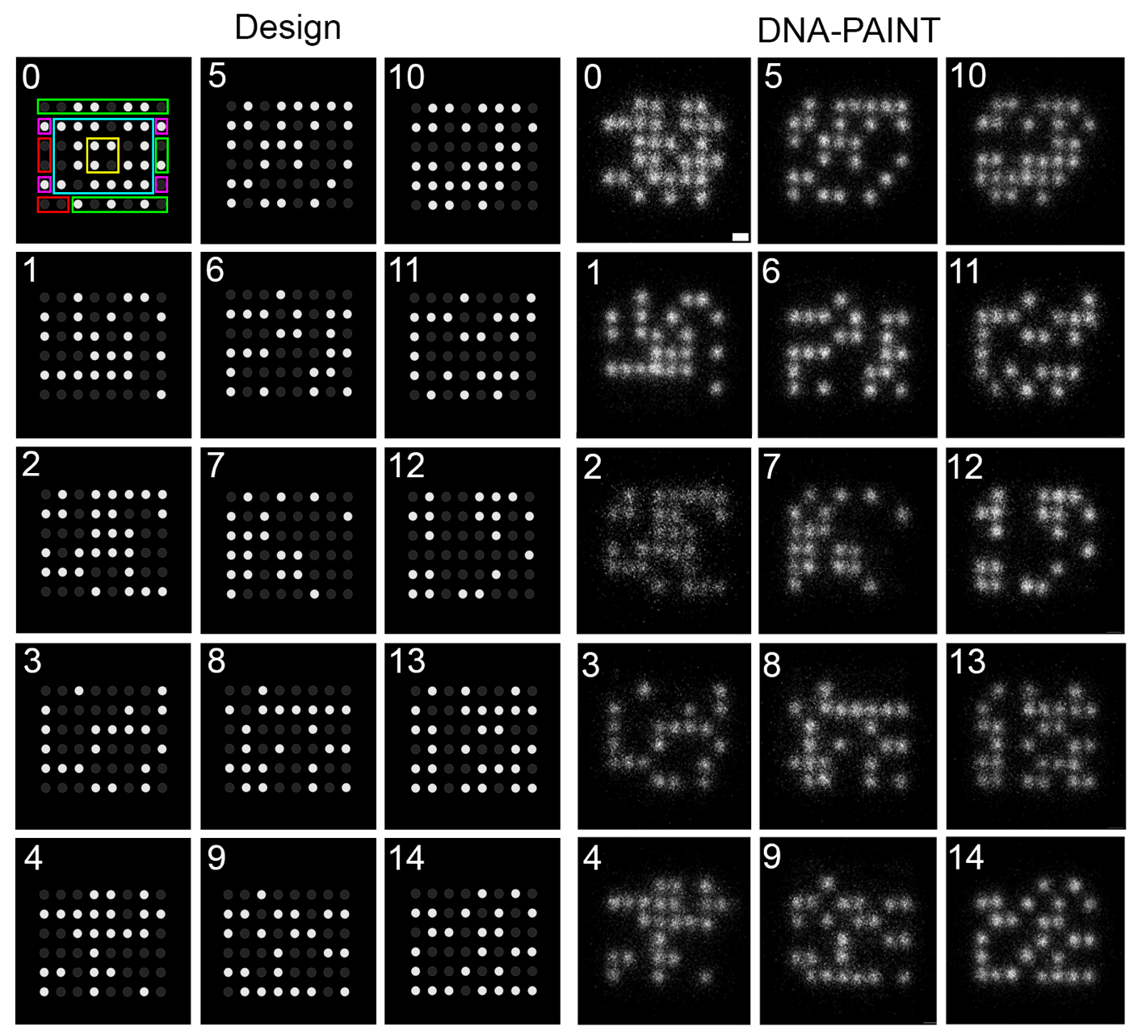
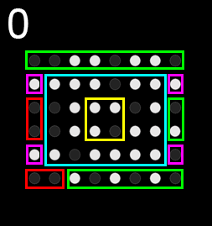
Coding – dNAM
LEGEND
data droplet
index
orientation
parity
checksum

Slide 2
Coding – fountain code basics
ATTRIBUTES
Not an error correction code
Provides robustness to losing data
It can recover the whole file even when sequences are missing
001101001
Split data into equal length segment
001 | 101 | 001
Index +
100
+ EC
Droplet
Droplet
Droplet
Droplet
Droplet

Slide 3
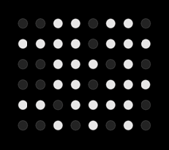
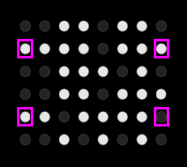
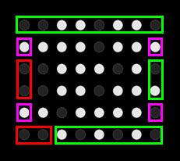
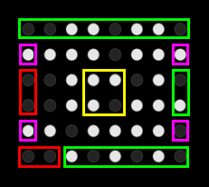
Coding – dNAM encoding
binary
Data is in our DNA!\n
01000100011000……
Divide data to generate segments
S₀ | S₁ | S₂ | S₃ | S₄ | S₅ | S₆ | S₇ | S₈ | S₉
0 | 0 | 1 | 1 | 0 | 1 | 1 | 0
1 |  |  |  |  |  |  | 1
0 |  |  |  |  |  |  | 0
0 |  |  |  |  |  |  | 1
1 |  |  |  |  |  |  | 0
0 | 0 | 1 | 0 | 1 | 0 | 1 | 0
0 | 0 | 1 | 1 | 0 | 1 | 1 | 0
1 |  |  |  |  |  |  | 1
0 |  |  |  |  |  |  | 0
0 |  |  |  |  |  |  | 1
1 |  |  |  |  |  |  | 0
0 | 0 | 1 | 0 | 1 | 0 | 1 | 0
1 |  |  |  |  |  |  | 1
1 |  |  |  |  |  |  | 0
Droplet
0011011001010101
Index
0000
Orientation bits
Data bits
Index bits
Checksum bits

Slide 4
dNAM encoding (mirror property)
0 | 0 | 1 | 1 | 0 | 1 | 1 | 0
1 |  |  |  |  |  |  | 1
0 |  |  |  |  |  |  | 0
0 |  |  |  |  |  |  | 1
1 |  |  |  |  |  |  | 0
0 | 0 | 1 | 0 | 1 | 0 | 1 | 0
Orientation bits
Data bits
Index bits
Checksum bits
Parity bits

Slide 5
dNAM encoding (Checksum)
0 | 0 | 1 | 1 | 0 | 1 | 1 | 0
1 |  |  |  |  |  |  | 1
0 |  |  |  |  |  |  | 0
0 |  |  |  |  |  |  | 1
1 |  |  |  |  |  |  | 0
0 | 0 | 1 | 0 | 1 | 0 | 1 | 0
1
1
1
0
Orientation bits
Data bits
Index bits
Checksum bits
Parity bits

Slide 6
Coding – dNAM encoding
0 | 0 | 1 | 1 | 0 | 1 | 1 | 0
0 | 1 | 1 | 1 | 0 | 1 | 1 | 1
0 | 0 | 1 | 1 | 1 | 0 | 1 | 0
0 | 0 | 0 | 1 | 0 | 1 | 1 | 1
1 | 1 | 0 | 1 | 1 | 1 | 1 | 0
0 | 0 | 1 | 0 | 1 | 0 | 1 | 0
Orientation bits
Data bits
Index bits
Checksum bits
Parity bits

Slide 7

Coding – dNAM decoding (data bits error probability)
0 | 0 | 1 | 1 | 0 | 1 | 1 | 0
0 | 1 | 1 | 1 | 0 | 1 | 1 | 1
0 | 0 | 1 | 1 | 1 | 0 | 1 | 0
0 | 0 | 0 | 1 | 0 | 1 | 1 | 1
1 | 1 | 0 | 1 | 1 | 1 | 1 | 0
0 | 0 | 1 | 0 | 1 | 0 | 1 | 0
0
Orientation bits
Data bits
Index bits
Checksum bits
Parity bits
Errors
15

Slide 8
Coding – dNAM decoding (data bits error probability)
1 | 1 | 1 | 1 | 1 | 1 | 0 | 2
5 |  |  |  |  |  |  | 1
1 |  |  | 1 | 2 |  |  | 2
2 |  |  | 0 | 1 |  |  | 0
1 |  |  |  |  |  |  | 2
2 | 1 | 1 | 1 | 1 | 0 | 2 | 0
Orientation bits
Data bits
Index bits
Checksum bits
Parity bits
Errors
15

Slide 9
Coding – dNAM decoding (data bits error probability)
1 | 1 | 1 | 1 | 1 | 1 | 0 | 2
5 |  |  |  |  |  |  | 1
1 |  |  | 1 | 2 |  |  | 2
2 |  |  | 0 | 1 |  |  | 0
1 |  |  |  |  |  |  | 2
2 | 1 | 1 | 1 | 1 | 0 | 2 | 0
Orientation bits
Data bits
Index bits
Checksum bits
Parity bits
Probable error
Errors
15

Slide 10
dNAM decoding (Parity bit error probability)
1 | 1 | 1 | 1 | 1 | 1 | 0 | 2
5 |  |  |  |  |  |  | 1
1 |  |  | 1 | 2 |  |  | 2
2 |  |  | 0 | 1 |  |  | 0
1 |  |  |  |  |  |  | 2
2 | 1 | 1 | 1 | 1 | 0 | 2 | 0
Orientation bits
Data bits
Index bits
Checksum bits
Parity bits
Probable error
Errors
15

Slide 11
dNAM decoding (Parity bit error probability)
1 | 1 | 1 | 1 | 1 | 1 | 0 | 2
5 | 3 | 6 | 4 | 3 | 4 | 5 | 1
1 | 7 | 6 | 1 | 2 | 1 | 2 | 2
2 | 4 | 6 | 0 | 1 | 3 | 7 | 0
1 | 2 | 3 | 4 | 2 | 3 | 4 | 2
2 | 1 | 1 | 1 | 1 | 0 | 2 | 0
Orientation bits
Data bits
Index bits
Checksum bits
Parity bits
Probable error
Errors
15

Slide 12
Coding – dNAM decoding (data & parity bits error probability)
1 | 1 | 1 | 1 | 1 | 1 | 0 | 2
5 | 3 | 6 | 4 | 3 | 4 | 5 | 1
1 | 7 | 6 | 1 | 2 | 1 | 2 | 2
2 | 4 | 6 | 0 | 1 | 3 | 7 | 0
1 | 2 | 3 | 4 | 2 | 3 | 4 | 2
2 | 1 | 1 | 1 | 1 | 0 | 2 | 0
Orientation bits
Data bits
Index bits
Checksum bits
Parity bits
Probable error
Errors
111 / 15 = 7.4
15

Slide 13
Coding – dNAM decoding (origami weight)
 |  |  |  |  |  |  | 9.4
1.3 |  | 6.12 |  |  |  | 8.35
 | 6.06 | 8.9 |  | 8.71 |  |  | 6.86
7.4 |  | 5.6 |  |  |  | 5.75
 |  |  |  |  |  |  | 7.9
8.0 |  |  |  |  |  | 9
Orientation bits
Data bits
Index bits
Checksum bits
Parity bits
Probable error
Errors

Slide 14

Coding – dNAM decoding (fixing errors)
 |  |  | 2.4
 | 3.1 | 0
Orientation bits
Data bits
Index bits
Checksum bits
Parity bits
Probable error
Errors
Fixed error

Slide 15
dNAM decoding (Fountain code decoding)
S₁
S₂
S₅
S₆
Droplet number | Segments present in that droplet
D₉ | S₅
D₂ | S₀,S₁, S₂, S₃, S₄, S₅, S₆
D₆ | S₀, S₁, S₂
D₁₂ | S₁, S₂,S₃, S₄
D₇ | S₁, S₂
D₈ | S₂
S₅
S₃, S₄, S₅,S₆
S₆
S₅, S₆
S₃, S₄
S₁
S₂

